Slide 1
Data Structures And Algorithms
Lecturer: Afshan Mehmood
afshan.mehmood@griffith.ie
Notes:
<number>

Slide 2
Lecture 02- Recursion
Java Recap
https://docs.oracle.com/javase/tutorial/java/javaOO/index.html
Recursion
1
Notes:
<number>

Slide 3
Objects
Object Orientation in computing was intended to make thinking about programming closer to thinking about the real world.
What is an object in real world?
Objects are separate from each other. They have their own identity.
Objects have characteristics (attributes).
Objects have behaviour.
1

Slide 4
Objects
In computing objects can represent real world objects that can be touched or seen. Objects in computing can also be things that we can not see or touch. For example, a bank account.
Objects are not always physical items.
Objects are not always visible items.
They have attributes. For example, balance, account number, etc.
They have behaviour. For example, deposit, withDraw, etc.
05/02/2018
1

Slide 5
Classes
Software systems are operational models of real or virtual world activities based around objects that populate these worlds.
For example, people, cars, houses, etc.
These objects are said to belong to a certain class.
05/02/2018
1
Notes:
All may have same attributes but different values.
For example, both Adam and John have a name attribute but with different values i.e. Adam and John. Thus, a class is a blueprint from which individual objects are created.
It provides a specification or a layout of how objects of that class should be created.
It specifies all common attributes of the objects that belongs to that class.
It also specifies all common behaviours of the objects that belongs to that class.
<number>

Slide 6
Defining Classes
In Java, a class is defined by a class keyword followed by a class name.
For example, the following Java code defines a class Person.
public class Person{
}
05/02/2018
1
Notes:
Classes can be defined as public, private, or protected
<number>

Slide 7
Defining Classes
Since real world objects have attributes and behaviours, we should also define objects’ attributes and behaviours in a class.
An attribute is defined by declaring a variable. In Java, an attribute is also called a field.
A behaviour is defined by declaring a method.
1

Slide 8
Defining Classes
The Person class with two attributes name and occupation and one behaviour called display().
public class Person{
private String name;
private String occupation;
public void display(){
System.out.println("Name of the person: "+ name);
System.out.println("Occupation of the person: "+ occupation);
}
}
05/02/2018
1

Slide 9
Constructors
To set values of attributes we need to declare constructors for a class.
A constructor is a method in a class definition that initializes attributes of the class.
A constructor also executes any instructions enclosed within it.
A constructor is declared as a method except it uses the name of a class and have no return type.
It typically takes all or some of attributes for the class as arguments.
05/02/2018
1

Slide 10
Constructors
A class can have none, one or more constructors.
If no constructor is declared (as in our Person class example), then Java compiler automatically adds a default constructor for that class.
A default constructor is added only if no constructor is declared for that class.
If more than one constructors are declared in a class, then they must have different argument lists i.e. different types and number of arguments.
05/02/2018
1

Slide 11
Defining Classes
The Person class with a two-argument constructor.
public class Person{
private String name;
private String occupation;
public Person(String n, String o){
name = n;
occupation = o;
}
public void display(){
System.out.println("Name of the person: "+ name);
System.out.println("Occupation of the person: "+ occupation);
}
}
05/02/2018
1
Notes:
<number>

Slide 12
Creating Objects
Now that we have defined the Person class, we can use it to create object(s).
Since OOD emphasizes modularization, we create this object(s) in another class.
It is also possible to create object(s) from within a class definition.
05/02/2018
1
Notes:
Object Oriented Design
<number>

Slide 13
Creating Objects
We can create a new class MyProgram.
In MyProgram class, we have to declare and assign a variable with a new Person object.
In this declaration, the Person class is used as a data type of this variable.
public class MyProgram{
public static void main(String[] args){
Person p = new Person("John", "Student");
}
}
05/02/2018
1
Notes:
The new keyword in our code is a Java operator.
It creates an object by allocating memory for the new object and returns a reference to that memory.
It also invokes the object’s constructor.
<number>

Slide 14
Invoke Methods
Since we have a display method in the Person class.
We can invoke this method as follows.
The dot (.) plays an important role in Java.
It connects classes and objects to their members.
public class MyProgram{
public static void main(String[] args){
Person p = new Person("John", "Student");
p.display();
}
}
05/02/2018
1

Slide 15
Setup the java environment on your machines (if you have).
Use java 8. See the following link for official instructions:
https://docs.oracle.com/javase/8/docs/technotes/guides/install/install_overview.html
Write and run simple helloworld and basic calculator like programs in java.
1
Notes:
https://docs.oracle.com/javase/tutorial/java/javaOO/index.html
IntelliJ IDEA
<number>

Slide 16
After Class videos to Watch
Java Tutorial:
https://www.youtube.com/watch?v=eIrMbAQSU34
Data Structures and Algorithms in Java:
https://www.youtube.com/watch?v=BBpAmxU_NQo

Slide 17
Recursion
Notes:
<number>

Slide 18
What is recursion?
Put simply a function is said to be recursive if it is defined in terms of itself
In Mathematics recursion is defined by two properties:
a base case
a set of rules that reduce the chain of invocations to the base case.
Notes:
A function/method where the solution to a problem depends on solutions to smaller/simpler versions of the same problem
The function is repeatedly broken down to a smaller/simpler problem similar to the original until it reaches a problem it knows the answer to
<number>

Slide 19
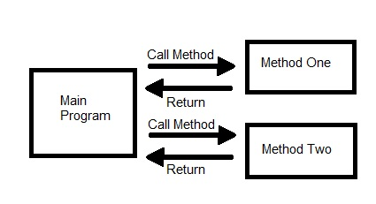
Hierarchical Method Calls
Most of the programs we have looked at so far are generally structured as methods or procedures that call one another in a disciplined, hierarchical manner
Notes:
<number>

Slide 20
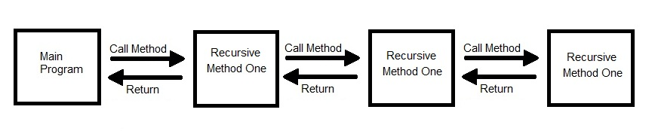
Recursive Method
However, for some types of problem, it is useful to have methods call themselves.
A recursive method is a method that calls a version of itself

Slide 21
What is Recursion?
The function actually knows how to solve only the simplest case(s), or so-called base-case(s)
If the method is called with a base case it simply returns the result
If the method is called with a more complex case then it divides the problem into
a piece it knows the answer to
a piece it does not know how to do

Slide 22
What is Recursion?
To make recursion feasible, the second piece (the piece it does not know how to do) must resemble the original problem, but be a slightly simpler or slightly smaller version of the original problem
Because this new problem looks like the original problem the method calls a copy of itself to work on the smaller problem.
This is called the recursion step

Slide 23
Recursion
The recursion step can result in many more recursive calls as the method keeps simplifying the problem
Each time the method calls itself with a slightly simpler version of the original problem
It is imperative that we ensure that the recursion terminates!
Thus, this sequence of smaller problems must eventually converge on the base case

Slide 24
Recursion
When the base case is reached, the method solves the base case and returns control to the calling method (the prior recursive call), it will then return control to its calling method all the way ‘up’ until the original call can return the final result
We will look at examples of some problems that can be solved recursively
Remember to look for
The base case
The recursive step

Slide 25

Factorial
Notes:
In Mathematics recursion is defined by two properties: a base case
and a set of rules that reduce the chain of invocations to the base case. For example, factorial
n is defined as:
<number>

Slide 26
Factorial
n! = n*(n-1)!
5! = 5*(5-1)! = 5*4!
= 5*4*(4-1)! = 5*4*3!
= 5*4*3*(3-1)! = 5*4*3*2!
= 5*4*3*2*(2-1)! = 5*4*3*2*1!
= 5*4*3*2*1*(1-1)! = 5*4*3*2*1*0!
= 5*4*3*2*1*1
= 120
The case when n = 0, base case, terminates the recursion.
Notes:
The base case is n = 0 and the rule that reduces the chain is n*(n-1)! Using this definition we
can find 5!
<number>

Slide 27
Recursion
Why do we need the base case?
In order to force recursion to terminate.
n! = n*(n-1)!
4! = 4*3! = 4*3*2!=4*3*2*1!
= 4*3*2*1*0!
= 4*3*2*1*0*-1!...
1

Slide 28
Natural numbers
In Mathematics recursion is also used to construct infinite sets of values.
Peano axioms:
(The Peano axioms define the arithmetical properties of natural numbers, usually represented as a set N)
1 is a Natural number (Rule 1)
if n is a Natural number , then n + 1 is a Natural number (Rule 2)
The set of natural numbers is the smallest set satisfying the previous two properties
Notes:
An axiom is a premise or starting point of reasoning. A self-evident principle or one that is accepted as true without proof as the basis for argument
Peano Axiom are a set of axioms for the natural numbers
<number>

Slide 29
Continued
Use the definition to show 3 is a Natural number
1∈N (R1)
⇒ 1+1 ∈N (R2)
= 2∈N (addition)
⇒ 2+1 ∈N (R2)
= 3∈N (addition)

Slide 30
Example
How to write an infinite sequence of a’s with a finite piece of text:
S = aS
= aaS = aaaS = aaaaS = …
Notes:
The power of recursion lies in the possibility of defining a potentially infinite set of objects
by a finite piece of text. The equation S = aS defines an infinite sequence of a’s
<number>

Slide 31
Programming with recursion
Consider a programming language that has no explicit repetitive statement…. No loops!
Repetition has to be coded with recursive calls on a given function
Each invocation of the function must make progress towards a terminating condition
Notes:
Consider a programming language that has no explicit repetitive statement. This hypothetical
language would only have input/output statements, assignment and an if statement. To
construct programs to repeat a task in such a language would necessitate the use of recursive
definition. The recursive definition could be implemented as a function, call it Rec, where the
function body of Rec contains an explicit reference to itself. To avoid the possibility of nonterminating
recursive calls, each invocation of Rec must make progress towards termination
and its body must contain a terminating condition. We illustrate this approach to writing
recursive functions with a number of examples.
<number>

Slide 32
Factorial n
Write a recursive function to compute factorial n, n >= 0.
Example – recursive function to compute factorial n:
static int fac(int n){
if(n == 0)
return 1;
else
return(n*fac(n-1));
}
The terminating condition is: n==0
Notes:
The solution is given by implementing the definition of n!, as given above.
The recursion is implemented, in this case, by including a reference to the function name as part of the return statement. In fact it uses the right hand side of the definition of n!, i.e. n*(n-1)!. In doing so it makes progress toward termination. The terminating condition is: n == 0. When this condition is satisfied the function returns 1 and terminates. This allows all the earlier executions of the return statement to terminate in turn.
<number>

Slide 33
The program FacN, listed in book page 29, tests the function fac(n).
Example – recursive function to compute factorial 3:
fac(3) = return(3*fac(2))
= return(3*[return(2*fac(1))])
= return(3*[return(2*[return(1*fac(0))]])
= return(3*[return(2*[return(1*1)]])
= return(3*[return(2*1])
= return(3*2)
= 6
The fac function is called again and again until the terminating case, n==0 is met.
Notes:
The recursive calls to fac descend until the terminating case, n == 0, is encountered. Each
call results in a calculation that involves multiplying n, a local variable, with the invocation
of fac(n-1). This may give rise to further invocations or terminate. This pattern is repeated
until the termination case is encountered. When this occurs we backtrack because each
invocation of fac completes and returns its part of the chain of computations. The final call,
fac(0), returns 1. This results in fac(1) completing and returning 1. Then fac(2) completes
returning 2 and so on until we reach the top.
<number>

Slide 34
Practice from book
Write a recursive procedure that reads a list of values, sentinel –1, and prints them in reverse order.
Solution on page 31 of Book.
See Example 2 and 3

Slide 35
Programming with Recursion
Write a recursive function that prints the decimal digits of a positive integer in words.
For example:
putDigits(209)
Output: two zero nine
1

Slide 36
Print the decimal digits of a positive integer in words.
static void putDigits(int n){ //assume n > 0
if(n > 0){
putDigits(n/10);
printWord(n%10);
}
}
static void printWord(int k){
String[] words={"zero","one","two","three", "four","five","six","seven","eight","nine"};
System.out.print(words[k]+" ");
}
1

Slide 37
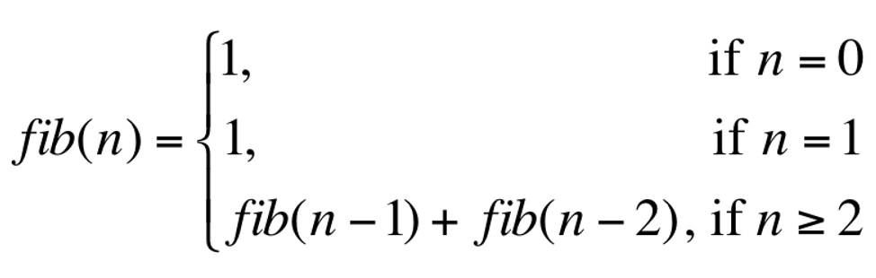
Fibonacci numbers
Write a program to compute the first n terms of the Fibonacci sequence, where the terms of the Fibonacci sequence are defined recursively as:
0 | 1 | 2 | 3 | 4 | 5 | 6 | 7 | 8 | 9
1 | 1 | 2 | 3 | 5 | 8 | 13 | 21 | 34 | 55
Notes:
A series of numbers in which each number (Fibonacci number) is the sum of the two preceding numbers.
<number>

Slide 38
Fibonacci
static int fib(int n){
if(n == 0 || n == 1)
return 1;
else
return( fib(n-1) + fib(n-2) );
}
Also, Can be solve using loop, see page 31-33 of Book.
This solution is correct; however, it is not very efficient because each term is generated independently of all other terms
Notes:
When the algorithm is called it immediately checks for the base case. If the base case occurs then 1 is returned.
If not, two recursive calls are made to the function, each a simpler version of the original problem
<number>

Slide 39
Listing files in a directory
Write a function that lists the names of all files in a folder including its subfolders.
Use File class in Java package java.io
Notes:
Java provides the package java.io that has a number of classes and associated methods that can be used in programs to access the file system on your disk, create new files, read information stored on file and process it, write new information to a file, etc.
The File class contained in this package provides the required methods to solve this problem
<number>

Slide 40
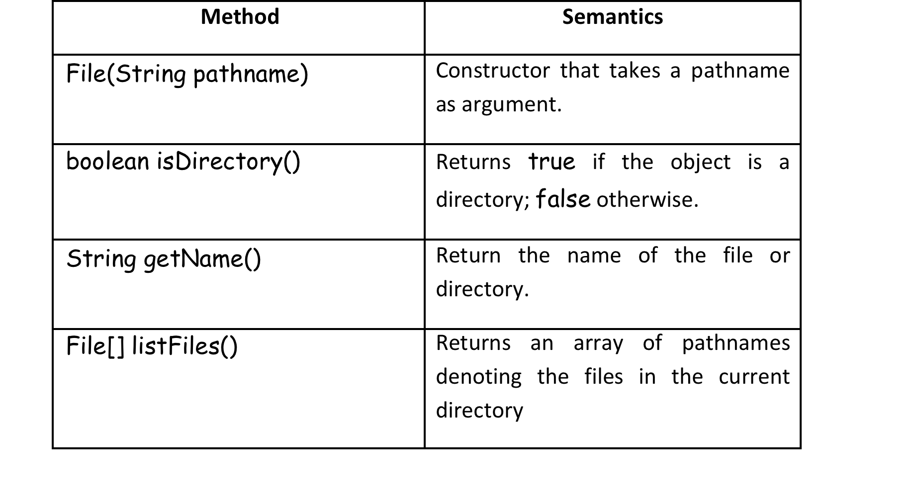
Listing files in a directory
Notes:
<number>

Slide 41
Listing files in a directory
static void listFiles(File dir){
File[] files = dir.listFiles();
if(files != null){
for(File f : files) {
if(f.isDirectory()) //recursive call here
listFiles(f);
else //print name of file
System.out.println(f.getName());
}
}
}
Notes:
The function displayFiles, listed below, takes the pathname of a directory as argument and recursively iterates over the files in the given directory and all sub-directories contained in it. The method listFiles returns an array of file names in the directory dir.
This list may contain actual files and also directory names. If files is not null then the loop iterates over the array.
For each file in the list it checks to see if it is a directory.
If so, it invokes displayFiles on it and, hence, recursively descends through the sub-directories; otherwise, it prints the name of the file.
<number>

Slide 42
Recursion over sequences
In the case of a sequence there are N terms to iterate over.
Usually, we process all of these terms left-to-right starting at index 0, the first term.
Therefore, the base case or terminating condition is reached when the given index value is N.
The successor of the current term is always index + 1.
A simple function that displays the values in an array is given on next slide.
Notes:
First: Array processing is a fundamental activity in all programming languages. In the normal
course of events we would use a for loop or a while loop to iterate over a given sequnce of
values. In this section we are going to look at an alternative way to do this by showing how to
write recursive functions that process elements in an array. we can also use recursion over sequences.
<number>

Slide 43
Recursion over sequences
static void display(int f[], int n){
if(n < f.length){
System.out.print(f[n]+" ");
display(f,n+1);
}
}
Notes:
It takes a reference to the array f and an index, n, as argument and if n is less than the size of the array it prints f[n] and then invokes the function again with index equal to n+1.
<number>

Slide 44

Recursion over sequences
Recursion over sequences.
Given an int array of N values write recursive functions to:
Compute the sum of the values in the array;
Linearly search the array for a given value x.
The sum function takes an array f and an index value as arguments. The definition is:
A function that implements this definition is:
static int sum(int f[], int n){
if(n == f.length){
return 0;
}else{
return(f[n] + sum(f,n+1));
}
}
Notes:
This function returns 0 when it terminates. The reason is because the sum over an empty sequence is always defined to be zero.
The function uses the stack to store values as it descends or iterates over the sequence.
When it terminates it backtracks accumulating the result as it goes.
<number>

Slide 45
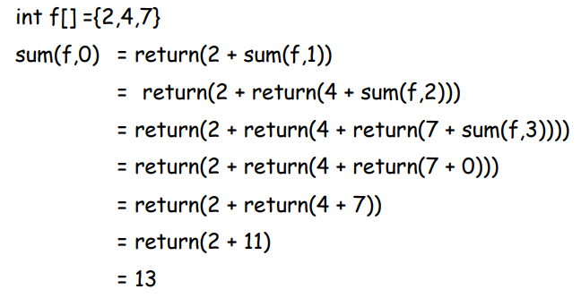
Recursion over sequences
Notes:
The example uses an array containing the sequence 2, 4, 7 to illustrate its semantics.
The recursive calls iterate over the sequence until the terminating condition is reached when n is 3.
This causes the value 0 to be returned and, hence, allows the previous calls to terminate.
<number>

Slide 46
Tail Recursion
Factorial Recursively
fac(n : Int) : Int = if(n==0) 1 else n*fac(n-1)
you notice that when it is evaluated the function is repeatedly invoked and this sequence only terminates when the parameter n has a value of 0.
fac(3) = 3*fac(2)
= 3*2*fac(1)
= 3*2*1*fac(0)
= 3*2*1*1
= 6
Stack to hold values until termination reached
For large N can get stack overflow
Notes:
To remember where to return the system must store values on the run-time stack. This means
that for large values of n your program may run out of stack space, i.e. the run-time stack
overflows. If this should happen, then your program will crash.
<number>

Slide 47
Tail Recursion
To avoid this you need to write the recursive function so that the last call to the function each time is the recursion itself.
A tail recursive function is a special case of recursion in which the last instruction executed in the method is the recursive call
This type of function uses what is termed an accumulator parameter
Notes:
End: The idea is to allow the function to accumulate the result as it
recursively invokes itself. In this way, the terminating state knows the result and can yield or
return it.
<number>

Slide 48
Tail Recursion
static int getFac(int a, int n0, int n){
if(n0 == n) return a;
else return getFac(a*(n0+1),n0+1,n);
}
static int fac(int n) {
if(n == 0) return 1;
else
return getFac(1,1,n);
}
There is an invariant relation between the first two parameters such that n0! = a.
When n0 equals n, a equals n!.
Notes:
To illustrate this approach we re-write fac(n) so that it uses an accumulator parameter. This
is difficult to do in Java because it does not allow nested functions. To keep with the original
function fac(n) we simply write another helper function, getFac, that takes three arguments:
the accumulator a, an integer n0 and the normal paramter n. There is an invariant relation
between the first two parameters such that n0! = a. When n0 equals n, a equals n!. This
function actually provides the recursive solution by accumulating the result. This means that
when it terminates the result can be returned immediately and there is no backtracking. As a
consequence, the stack will not overflow and the performance of the function improves
because it doesn’t have to calculate the solution by backtracking.
<number>

Slide 49
Think!
To illustrate this, we calculate fac(5) as follows:
fac(5) => getFac(1,1,5) => getFac(2,2,5) => getFac(6,3,5) => getFac(24,4,5) => getFac(120,5,5) => 120
Notice that the stack is not used to store the result term by term as before. Instead, each invocation of getFac completes and the result is accumulated in parameter a. Hence, when it terminates the result is just the value of a.

Slide 50
Practice question
Write a function to compute fib(n), a term in the Fibonacci sequence, that is defined recursively as:
Sol:
public int fib(int n) {
if (n <= 1) {
return 1; }
else {
return fib(n-1) + fib(n-2);
}
}

Slide 51
Practice question
Write a recursive function that computes the sum of the terms in an integer array.
Answer
public int sum(int[] f, int i) {
if (i == f.length)
return 0;
else {
return f[i] + sum(f,i+1);
}
}

Slide 52
Practice question
Given below is a recursive function called fac that calculates n! Use this function to calculate fac(5).
static int fac(int n){
if(n == 0) return 1;
else return n * fac(n-1);
}
Answer
Fac(5) = 5*fac(4) = 5*4*fac(4)=5*4*2*fac(2) = … = 120

Slide 53
Self Study

Slide 54
Binary Search
Any problem that can be solved recursively can also be solved iteratively (using a loop)
Let us look at Binary Search both recursively & Iteratively

Slide 55
Iterative Solution
Given a sorted array of integers and some integer x, write code to determine if x is an element of the array
The strategy is to repeatedly start with the middle element and continuously halve the size of the search space until it reaches a segment of size 1

Slide 56
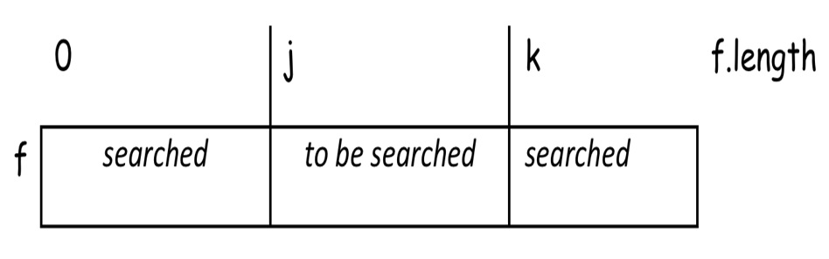
Iterative Solution
An invariant diagram to describe this strategy is:

Slide 57
Iterative Solution
This solution describes the binary search in terms of a loop construct. A static function that defines its implementation is given below.
static boolean binSearch(int f[],int x){
int j = 0;
int k = f.length;
while(j + 1 != k){
int i = (j + k)/2;
if( x >= f[i])
j = i;
else
k = i;
}
return(f[j]==x);
}

Slide 58
Binary Searching
This is an iterative solution that uses a while loop to control the search.
We can also write a recursive solution by passing the lower and upper bounds to the search function as arguments.
Like the iterative solution above, the recursion terminates when a segment of size 1 is isolated. For all segments of size larger than 1 the middle term is compared with x and the appropriate new segment is searched.

Slide 59
Recursive Binary Search
boolean binarySearch(int f[], int lb, int ub, int x){
if(lb+1 == ub) return (f[lb] == x);
else{
int mid = (lb+ub)/2;
if(x >= f[mid])
return binarySearch(f,mid,ub,x);
else
return binarySearch(f,lb,mid,x);
}
}

